Slide 1


21CSC203P - Advanced Programming Practice Unit-4 : PYTHONIC PROGRAMMING PARADIGM

Slide 2
Outline of the course Functional Programming Paradigm: Concepts, PureFunction and Built-in Higher-Order Functions; Logic Programming Paradigm: Structures, Logic, and Control Parallel Programming Paradigm: Shared and Distributed memory Multi-Processing – Ipython Network Programming Paradigm: Socket; Socket Types; Creation and Configuration of Sockets in TCP / UDP – Client / Server Model

Slide 3
Introduction
Functional programming is a programming paradigm in which it is tried to bind each and everything in pure mathematical functions. It is a declarative type of programming style that focuses on what to solve rather than how to solve.
Functional programming paradigm is based on lambda calculus.
Instead of statements, functional programming makes use of expressions. Unlike a statement, which is executed to assign variables, evaluation of an expression produces a value.
Functional programming is a declarative paradigm because it relies on expressions and declarations rather than statements. Unlike procedures that depend on a local or global state, value outputs in FP depend only on the arguments passed to the function.
Functional programming consists only of PURE functions.
In functional programming, control flow is expressed by combining function calls, rather than by assigning values to variables. Example:

Slide 4
Characteristics of Functional Programming
Functional programming method focuses on results, not the process
Emphasis is on what is to be computed
Data is immutable
Functional programming Decompose the problem into 'functions
It is built on the concept of mathematical functions which uses conditional expressions and recursion to do perform the calculation
It does not support iteration like loop statements and conditional statements like If-Else
Functional programming languages are designed on the concept of mathematical functions that use conditional expressions and recursion to perform computation.
Functional programming supports higher-order functions and lazy evaluation features.
Functional programming languages don’t support flow Controls like loop statements and conditional statements like If-Else and Switch Statements. They directly use the functions and functional calls.

Slide 5
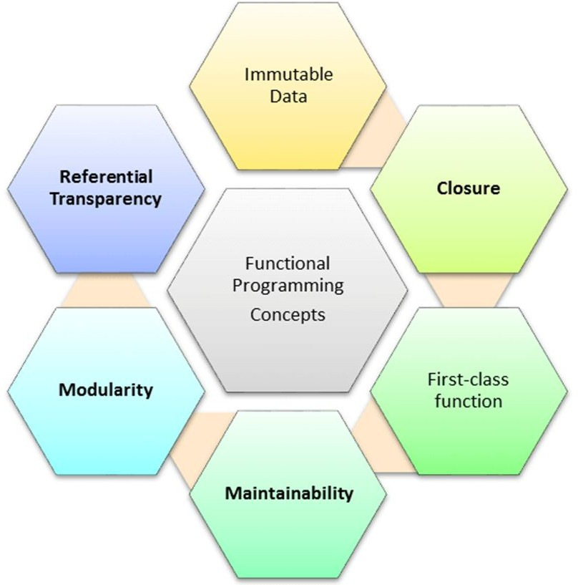
Concepts of FP
Pure functions
Recursion
Referential transparency
Functions are First-Class and can be Higher-Order
Immutability

Slide 6
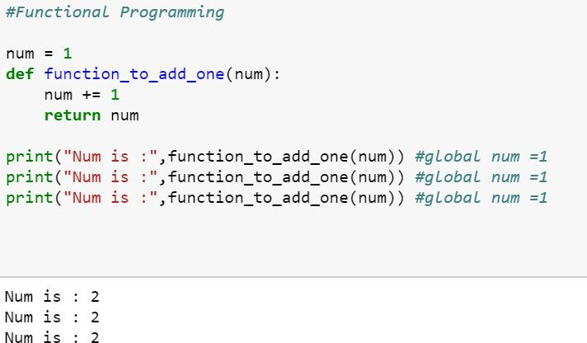
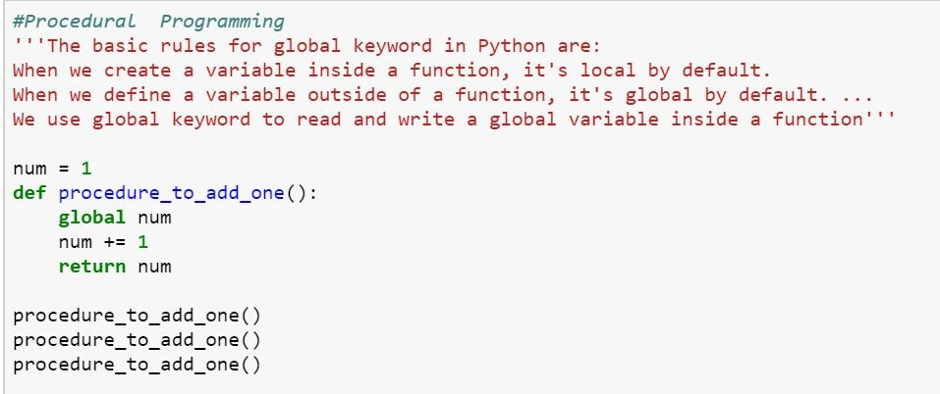
Functional Programming vs Procedure Programming

Slide 7
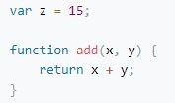
1. Pure functions
Pure functions always return the same results when given the same inputs. Consequently, they have no side effects.
Properties of Pure functions are:
First, they always produce the same output for same arguments irrespective of anything else.
Secondly, they have no side-effects i.e. they do modify any argument or global variables or output something.
A simple example would be a function to receive a collection of numbers and expect it to increment each element of this collection.
We receive the numbers collection, use map with the inc function to increment each number, and return a new list of incremented numbers.
Example:
def inc(x):
return x+1 list=[8,3,7,5,2,6]
x=map(inc,list) #print(list) print(x)
Note : Function involving Reading files,
using global data, random numbers are impure functions
Note: if a function relies on the global variable or class member’s data, then it is not pure. And in such cases, the return value of that function is not entirely dependent on the list of arguments received as input and can also have side effects.
A side effect is a change in the state of an application that is observable outside the called function other than its return value

Slide 8
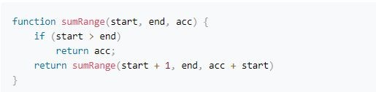
2. Recursion
In the functional programming paradigm, there is no for and while loops. Instead, functional programming languages rely on recursion for iteration. Recursion is implemented using recursive functions, which repetitively call themselves until the base case is reached.
The above code performs recursion task as the loop by calling itself with a new start and a new accumulator.

Slide 9
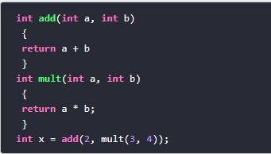
Referential transparency
An expression is said to be referentially transparent if it can be replaced with its corresponding value without changing the program's behaviour. As a result, evaluating a referentially transparent function gives the same value for fixed arguments. If a function consistently yields the same result for the same input, it is referentially transparent.
Functional programs don’t have any assignment statements. For storing additional values in a program developed using functional programming, new variables must be defined. State of a variable in such a program is constant at any moment in time
pure function + immutable date = referential transparency
Let’s implement a square function:
This (pure) function will always have the same output, given the same input.
Passing “2” as a parameter of the square function will always returns 4. So now we can replace the (square 2) with 4.

Slide 10

Immutability
In functional programming you cannot modify a variable after it has been initialized. You can create new variables and this helps to maintain state throughout the runtime of a program.
In imperative programming, this means “take the current value of x, add 1 and put the result back into x.” In functional programming, however, x = x + 1 is illegal. That’s because there are technically no variables in functional programming.
Using immutable data structures, you can make single or multi-valued changes by copying the variables and calculating new values,
Since FP doesn’t depend on shared states, all data in functional code must be immutable, or incapable of changing

Slide 11
Functions are First-Class and can be Higher-Order
A programming language is said to have First-class functions when functions in that language are treated like any other variable. For example, in such a language, a function can be passed as an argument to other functions, can be returned by another function and can be assigned as a value to a variable.
Higher-order functions are functions that take at least one first-class function as a parameter
Examples:
name_lengths = map(len, ["Bob", "Rob", "Bobby"])
Higher Order functions are map, reduce, filter
Functional style of getting a sum of a list:
new_lst = [1, 2, 3, 4] def sum_list(lst):
if len(lst) == 1: return lst[0]
else:
return lst[0] + sum_list(lst[1:]) print(sum_list(new_lst))
# or the pure functional way in python using higher order function
import functools
print(functools.reduce(lambda x, y: x + y, new_lst))

Slide 12
Functions are First-Class and can be Higher-Order
Map
map() can run the function on each item and insert the return values into the new collection. Example: squares = map(lambda x: x * x, [0, 1, 2, 3, 4])
import random
names = ['Seth', 'Ann', 'Morganna']
team_names = map(lambda x: random.choice(['A Team','B Team']),names) print names
// ['A Team', 'B Team', 'B Team']
reduce()
reduce() is another higher order function for performing iterations. It takes functions and collections of items, and then it returns the value of combining the items
Example:
sum = reduce(lambda a, x: a + x, [0, 1, 2, 3, 4]) print sum // 10

Slide 13
Functions are First-Class and can be Higher-Order ..cont
filter()
filter function expects a true or false value to determine if the element should or should not be included in the result collection. Basically, if the call-back expression is true, the filter function will include the element in the result collection. Otherwise, it will not.
Example:
def f(x):
return x%2 != 0 and x%3 ==0 filter(f, range(2,25))

Slide 14
Functional Programming – Non Strict Evaluation
In programming language theory, lazy evaluation, or call-by-need[1] is an evaluation strategy which delays the evaluation of an expression until its value is needed (non-strict evaluation) and which also avoids repeated evaluations
Allows Functions having variables that have not yet been computed
In Python, the logical expression operators and, or, and if-then-else are all non-strict. We sometimes call them short-circuit operators because they don't need to evaluate all arguments to determine the resulting value.
The following command snippet shows the and operator's non-strict feature:
>>> 0 and print("right") 0
>>> True and print("right") Right
When we execute the preceding command snippet, the left-hand side of the and operator is equivalent to False; the right-hand side is not evaluated. When the left-hand side is equivalent to True, the right-hand side is evaluated

Slide 15
Functional Programming – lambda calculus
Lambda expressions in Python and other programming languages have their roots in lambda calculus. Lambda calculus can encode any computation. Functional languages get their origin in mathematical logic and lambda calculus
In Python, we use the lambda keyword to declare an anonymous function, which is why we refer to them as "lambda functions". An anonymous function refers to a function declared with no name.
when you want to pass a function as an argument to higher-order functions, that is, functions that take other functions as their arguments
Characteristics of Python lambda functions:
A lambda function can take any number of arguments, but they contain only a single expression. An expression is a piece of code executed by the lambda function, which may or may not return any value.
Lambda functions can be used to return function objects.
Syntactically, lambda functions are restricted to only a single expression.
Syntax:
lambda argument(s): expression
Example:
remainder = lambda num: num % 2 print(remainder(5))
[(lambda x: x*x)(x) for x in [2,6,9,3,6,4,8]]

Slide 16
Functional Programming – Closure
Basically, the method of binding data to a function without actually passing them as parameters is called closure. It is a function object that remembers values in enclosing scopes even if they are not present in memory.
Example:.
def counter(start=0, step=1): x = [start]
def _inc(): x[0] += step return x[0]
return _inc c1 = counter()
c2 = counter(100, -10) c1()
//1 c2() 90

Slide 17
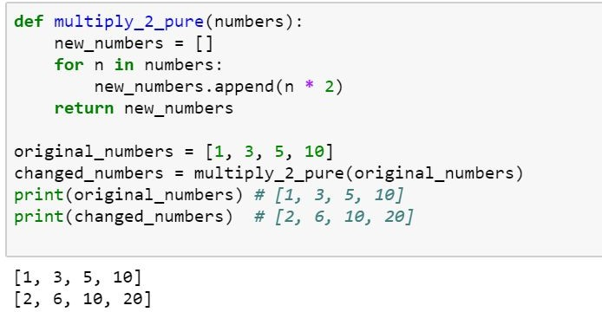
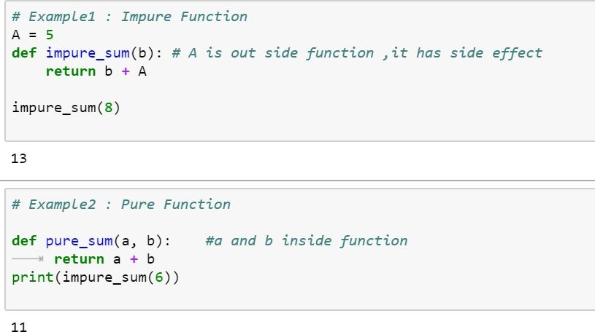
Pure Functions in Python
If a function uses an object from a higher scope or random numbers, communicates with files and so on, it might be impure

Slide 18
Built-in Higher Order Functions
Map
The map function allows us to apply a function to every element in an iterable object
Filter
The filter function tests every element in an iterable object with a function that returns either True or False, only keeping those which evaluates to True.
Combining map and filter
As each function returns an iterator, and they both accept iterable objects, we can use them together for some really expressive data manipulations!
List Comprehensions
A popular Python feature that appears prominently in Functional Programming Languages is list comprehensions. Like the map and filter functions, list comprehensions allow us to modify data in a concise, expressive way.

Slide 19
Anonymous Function
In Python, anonymous function is a function that is defined without a name.
While normal functions are defined using the def keyword, in Python anonymous functions are defined using the lambda keyword.
Characteristics of Python lambda functions:
A lambda function can take any number of arguments, but they contain only a single expression. An expression is a piece of code executed by the lambda function, which may or may not return any value.
Lambda functions can be used to return function objects.
Syntactically, lambda functions are restricted to only a single expression.
Syntax of Lambda Function in python
lambda arguments: expression
Example:
double = lambda x: x * 2 print(double(5))
# Output: 10
product = lambda x, y : x * y print(product(2, 3))
Note: you want to pass a function as an argument to higher-order functions, that is, functions that take other functions as their arguments.

Slide 20
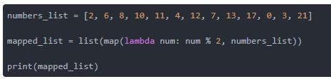
map() Function
Example Map with lambda
tup= (5, 7, 22, 97, 54, 62, 77, 23, 73, 61)
newtuple = tuple(map(lambda x: x+3 , tup)) print(newtuple)
//with multiple iterables
list_a = [1, 2, 3]
list_b = [10, 20, 30]
map(lambda x, y: x + y, list_a, list_b)
Example with Map from math import sqrt map(sqrt, [1, 4, 9, 16])
[1.0, 2.0, 3.0, 4.0]
map(str.lower, ['A', 'b', 'C'])
['a', 'b', 'c']
#splitting the input and convert to int using map print(list(map(int, input.split(‘ ‘)))

Slide 21
map() Function
map() function is a type of higher-order. As mentioned earlier, this function takes another function as a parameter along with a sequence of iterables and returns an output after applying the function to each iterable present in the sequence.
Syntax:
map(function, iterables)
Example without Map
my_pets = ['alfred', 'tabitha', 'william', 'arla'] uppered_pets = []
for pet in my_pets:
Example with Map
my_pets = ['alfred', 'tabitha', 'william', 'arla'] uppered_pets=list(map(str.upper,my_pets)) print(uppered_pets)
//map with multiple list as input
circle_areas = [3.56773, 5.57668, 4.00914, 56.24241, 9.01344, 32.00013]
result = list(map(round, circle_areas, range(1,7))) print(result)
pet_=pet.upper() uppered_pets.append(pet_)
print(uppered_pets)

Slide 22
filter() Function
filter extracts each element in the sequence for which the function returns True.
filter(), first of all, requires the function to return boolean values (true or false) and then passes each element in the iterable through the function, "filtering" away those that are false
Syntax:
filter(func, iterable)
The following points are to be noted regarding filter():
Unlike map(), only one iterable is required.
The func argument is required to return a boolean type. If it doesn't, filter simply returns the iterable passed to it. Also, as only one iterable is required, it's implicit that func must only take one argument.
filter passes each element in the iterable through func and returns only the ones that evaluate to true. I mean, it's right there in the name -- a "filter".
Example:
def isOdd(x): return x % 2 == 1 filter(isOdd, [1, 2, 3, 4])
# output ---> [1, 3]

Slide 23
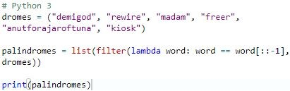
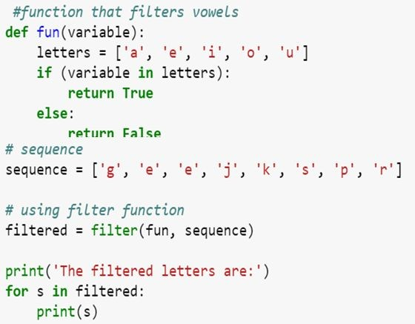
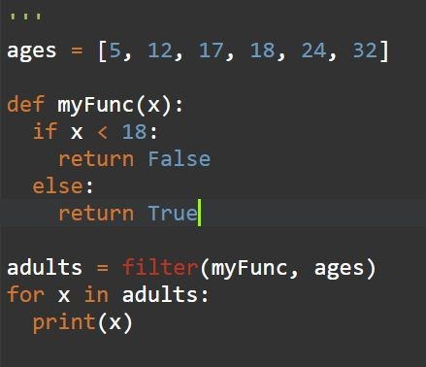
filter() Function
Example:
# Python 3
scores = [66, 90, 68, 59, 76, 60, 88, 74, 81, 65]
def is_A_student(score): return score > 75
over_75 = list(filter(is_A_student, scores)) print(over_75)

Slide 24
reduce() Function
reduce, combines the elements of the sequence together, using a binary function. In addition to the function and the list, it also takes an initial value that initializes the reduction, and that ends up being the return value if the list is empty.
The “reduce” function will transform a given list into a single value by applying a given function continuously to all the elements. It basically keeps operating on pairs of elements until there are no more elements left.
reduce applies a function of two arguments cumulatively to the elements of an iterable, optionally starting with an initial argument
Syntax:
reduce(func, iterable[, initial])
Example:
reduce(lambda s,x: s+str(x), [1, 2, 3, 4], '')
#output '1234‘
my_list = [3,8,4,9,5] reduce(lambda a, b: a * b, my_list) #output 4320 ( 3*8*4*9*5)
from functools import reduce
y = filter(lambda x: (x>=3), (1,2,3,4)) print(list(y))
reduce(lambda a,b: a+b,[23,21,45,98])
nums = [92, 27, 63, 43, 88, 8, 38, 91, 47, 74, 18, 16,
29, 21, 60, 27, 62, 59, 86, 56]
sum = reduce(lambda x, y : x + y, nums) / len(nums)

Slide 25
map(), filter() and reduce() Function
Using filter() within map():
c = map(lambda x:x+x,filter(lambda x: (x>=3), (1,2,3,4))) print(list(c))
Using map() within filter():
c = filter(lambda x: (x>=3),map(lambda x:x+x, (1,2,3,4))) #lambda x: (x>=3) print(list(c))
Using map() and filter() within reduce():
d = reduce(lambda x,y: x+y,map(lambda x:x+x,filter(lambda x: (x>=3), (1,2,3,4)))) print(d)

Slide 26
map(), filter() and reduce() Function
from functools import reduce
# Use map to print the square of each numbers rounded# to two decimal places
my_floats = [4.35, 6.09, 3.25, 9.77, 2.16, 8.88, 4.59]
# Use filter to print only the names that are less than or equal to seven letters
my_names = ["olumide", "akinremi", "josiah", "temidayo", "omoseun"]
# Use reduce to print the product of these numbers
my_numbers = [4, 6, 9, 23, 5]
map_result = list(map(lambda x: round(x ** 2, 3), my_floats)) filter_result = list(filter(lambda name: len(name) <= 7, my_names))
reduce_result = reduce(lambda num1, num2: num1 * num2, my_numbers) print(map_result)
print(filter_result) print(reduce_result)

Slide 27
Examples
#print the sum of even numbers from the user input import functools
l = input("Enter the list of numbers separated by space").split(" ") l = map(int,l)
def even_fil(x): flag = False if x%2==0:
flag=True return flag
even = list(filter(even_fil,l)) print(even)
s = functools.reduce(lambda x,y:x+y,even)

Slide 28
Examples
//Closure def twice(x):
def square(): return x*x
return square()*square() def quad(x):
return twice(x) print(quad(3))

Slide 29
Examples
//partial to make some of the parameters as fixed import functools
def s_total(a,b,c):
return a*b+c #a=5,b=15, c=from list s = functools.partial(s_total,5,15)
l= [13,54,76,89,10]
for i in l: print(s(i))

Slide 30
Function vs Procedure
S.No Functional Paradigms
Procedural Paradigm
Derived from structured programming, based on the concept of modular programming or the procedure call
Main traits are Local variables, sequence, selection, iteration, and modularization
Procedural programming focuses on statements
The output of a routine does not always have a direct correlation with the input.
Everything is done in a specific order. Execution of a routine may have side effects.
Tends to emphasize implementing solutions in a linear fashion.
1
Treats computation as the evaluation of mathematical functions avoiding state and mutable data
2
Main traits are Lambda
alculus, compositionality, formula, recursion, referential transparency
Functional programming focuses on expressions
3
4
Often recursive. Always returns the same output for a given input.
5
Order of evaluation is usually undefined.
6
Must be stateless. i.e. No operation can have side effects.
Good fit for parallel execution, Tends to emphasize a divide and conquer approach.
7

Slide 31
Function vs Object Oriented
S.No
Functional Paradigms
Object Oriented Paradigm
OOP uses Mutable data.
Follows Imperative Programming Model.
What it focuses is on "How you are doing your programming."
No supports for Parallel Programming. Method can produce many side effects.
Flow control process is conducted using loops and conditional statements.
Execution order of statements is important.
Supports only "Abstraction over Data".
1
FP uses Immutable data.
2
Follows Declarative Programming based Model.
3
What it focuses is on: "What you are doing. in the programme."
Supports Parallel Programming. Its functions have no-side effects.
Flow Control is performed using function calls & function calls with recursion.
Execution order of statements is not very important.
4
5
6
7
8
Supports both "Abstraction over Data" and "Abstraction over Behavior."

Slide 32
Logical Programming Paradigm

Slide 33
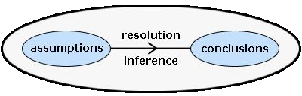
Logical Programming Paradigm
Logic programming is a paradigm where computation arises from proof search in a logic according to a fixed, predictable strategy. A logic is a language. It has syntax and semantics. A logic is a language. It has syntax and semantics. More than a language, it has inference rules.
Syntax:
this is the rules about how to form formulas; this is usually the easy part of a logic.
Semantics:
About the meaning carried by the formulas, mainly in terms of logical consequences.
Inference rules:
Inference rules describe correct ways to derive conclusions

Slide 34
Logical Programming Paradigm
Logic :
A Logic program is a set of predicates.
Predicates :
Define relations between their arguments. Logically, a Logic program states what holds. Each predicate has a name, and zero or more arguments. The predicate name is a atom. Each argument is an arbitrary Logic term. A predicate is defined by a collection of clauses.
Clause :
A clause is either a rule or a fact. The clauses that constitute a predicate denote logical alternatives: If any clause is true, then the whole predicate is true.

Slide 35
Logical Programming Paradigm
Fact
A fact must start with a predicate (which is an atom). The predicate may be followed by one or more arguments which are enclosed by parentheses. The arguments can be atoms (in this case, these atoms are treated as constants), numbers, variables or lists.
Facts are axioms; relations between terms that are assumed to be true. Example facts:
+big('bear')
+big('elephant')
+small('cat')
+brown('bear')
+black('cat')
+grey('elephant')
Consider the 3 fact saying ‘cat’ is a smallest animal and fact 6 saying the elephant is grey in color

Slide 36
Logical Programming Paradigm
Rule
Rules are theorems that allow new inferences to be made.
Describe Relationships Using other Relationships. Example
Two people are sisters if they are both female and have the same parents. Gives a definition of one relationship given other relationships.
Both must be females.
Both must have the same parents.
If two people satisfy these rules, then they are sisters (according to our simplified relationship)
dark(X)<=black(X) dark(X)<=brown(X)
Consider rule 1 saying the animal color is black its consider to be dark color animal

Slide 37
Logical Programming Paradigm
Queries
A query is a statement starting with a predicate and followed by its arguments, some of which are variables. Similar to goals, the predicate of a valid query must have appeared in at least one fact or rule in the consulted program, and the number of arguments in the query must be the same as that appears in the consulted program.
print(pyDatalog.ask('father_of(X,jess)'))
Output:
{('jack',)} X
print(father_of(X,'jess'))
Output:
jack X

Slide 38
Anatomy Logical Programming Paradigm
Fact
X +male('adam')
Predicat e
Clause
son(X,Y)<= male(X) & parent(Y,X)
Query
print(pyDatalog.ask('son(adam,Y)'))

Slide 39
Logical Programming Paradigm
from pyDatalog import pyDatalog pyDatalog.create_atoms('parent,male,female,son,daughter,X,Y,Z')
+male('adam')
+female('anne')
+female('barney')
+male('james')
+parent('barney','adam')
+parent('james','anne')
#The first rule is read as follows: for all X and Y, X is the son of Y if there exists X and Y such that Y is the parent of X and X is male.
#The second rule is read as follows: for all X and Y, X is the daughter of Y if there exists X and Y such that Y is the parent of X and X is female.
son(X,Y)<= male(X) & parent(Y,X) daughter(X,Y)<= parent(Y,X) & female(X) print(pyDatalog.ask('son(adam,Y)')) print(pyDatalog.ask('daughter(anne,Y)')) print(son('adam',X))

Slide 40
Logical Programming Paradigm
pyDatalog.create_terms('factorial, N') factorial[N] = N*factorial[N-1] factorial[1] = 1
print(factorial[3]==N)

Slide 41
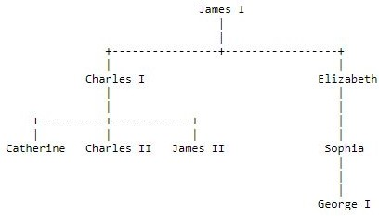
Logical Programming Paradigm

Slide 42
Logical Programming Paradigm
from pyDatalog import pyDatalog
pyDatalog.create_terms('X,Y,Z, works_in, department_size, manager, indirect_manager, count_of_indirect_reports') # Mary works in Production
+works_in('Mary', 'Production')
+works_in('Sam', 'Marketing')
+works_in('John', 'Production')
+works_in('John', 'Marketing')
+(manager['Mary'] == 'John')
+(manager['Sam'] == 'Mary')
+(manager['Tom'] == 'Mary')
indirect_manager(X,Y) <= (manager[X] == Y) print(works_in(X, 'Marketing'))
indirect_manager(X,Y) <= (manager[X] == Z) & indirect_manager(Z,Y) print(indirect_manager('Sam',X))

Slide 43
Logical Programming Paradigm
Lucy is a Professor Danny is a Professor James is a Lecturer
All professors are Dean
Write a Query to reterive all deans?
Soln
from pyDatalog import pyDatalog pyDatalog.create_terms('X,Y,Z,professor,lecturer, dean')
+professor('lucy')
+professor('danny')
+lecturer('james') dean(X)<=professor(X) print(dean(X))

Slide 44
Logical Programming Paradigm
likes(john, susie). likes(X, susie). likes(john, Y).
/* John likes Susie */
/* Everyone likes Susie */
/* John likes everybody */
likes(john, Y), likes(Y, john). /* John likes everybody and everybody likes John */ likes(john, susie); likes(john,mary). /* John likes Susie or John likes Mary */ not(likes(john,pizza)). /* John does not like pizza */
likes(john,susie) :- likes(john,mary)./* John likes Susie if John likes Mary.
rules
friends(X,Y) :- likes(X,Y),likes(Y,X).
hates(X,Y) :- not(likes(X,Y)).
/* X and Y are friends if they like each other */
/* X hates Y if X does not like Y. */
enemies(X,Y) :- not(likes(X,Y)),not(likes(Y,X)). /* X and Y are enemies if they don't like each other */

Slide 45
Parallel Programming Paradigm

Slide 46
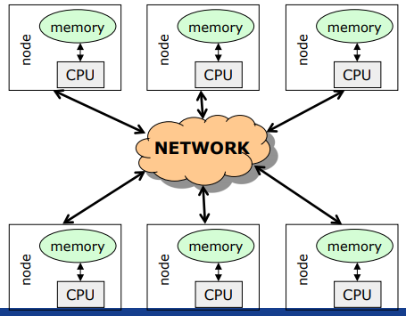
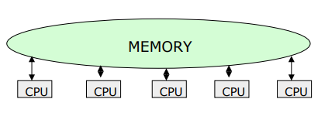
Introduction
A system is said to be parallel if it can support two or more actions executing simultaneously i.e., multiple actions are simultaneously executed in parallel systems.
The evolution of parallel processing, even if slow, gave rise to a considerable variety of programming paradigms.
Parallelism Types:
Explicit Parallelism
Implicit Parallelism
Message Passing Architecture
Shared memory Architecture

Slide 47
Explicit parallelism
Explicit Parallelism is characterized by the presence of explicit constructs in the programming language, aimed at describing (to a certain degree of detail) the way in which the parallel computation will take place.
A wide range of solutions exists within this framework. One extreme is represented by the ``ancient'' use of basic, low level mechanisms to deal with parallelism--like fork/join primitives, semaphores, etc--eventually added to existing programming languages. Although this allows the highest degree of flexibility (any form of parallel control can be implemented in terms of the basic low level primitives gif), it leaves the additional layer of complexity completely on the shoulders of the programmer, making his task extremely complicate.

Slide 48
Implicit Parallelism
Allows programmers to write their programs without any concern about the exploitation of parallelism. Exploitation of parallelism is instead automatically performed by the compiler and/or the runtime system. In this way the parallelism is transparent to the programmer maintaining the complexity of software development at the same level of standard sequential programming.
Extracting parallelism implicitly is not an easy task. For imperative programming languages, the complexity of the problem is almost prohibitively and allows positive results only for restricted sets of applications (e.g., applications which perform intensive operations on arrays.
Declarative Programming languages, and in particular Functional and Logic languages, are characterized by a very high level of abstraction, allowing the programmer to focus on what the problem is and leaving implicit many details of how the problem should be solved.
Declarative languages have opened new doors to automatic exploitation of parallelism. Their focusing on a high level description of the problem and their mathematical nature turned into positive properties for implicit exploitation of parallelism.

Slide 49
Methods for parallelism
There are many methods of programming parallel computers. Two of the most common are message passing and data parallel.
Message Passing - the user makes calls to libraries to explicitly share information between processors.
Data Parallel - data partitioning determines parallelism
Shared Memory - multiple processes sharing common memory space
Remote Memory Operation - set of processes in which a process can access the memory of another process without its participation
Threads - a single process having multiple (concurrent) execution paths
Combined Models - composed of two or more of the above.

Slide 50
Methods for parallelism
Message Passing:
Each Processor has direct access only to its local memory
Processors are connected via high-speed interconnect
Data exchange is done via explicit processor-to-processor communication i.e processes communicate by sending and receiving messages : send/receive messages
Data transfer requires cooperative operations to be performed by each process (a send operation must have matching receive)
Data Parallel:
Each process works on a different part of the same data structure
Processors have direct access to global memory and I/O through bus or fast switching network
Each processor also has its own memory (cache)
Data structures are shared in global address space
Concurrent access to shared memory must be coordinate
All message passing is done invisibly to the programmer

Slide 51
Steps in Parallelism
Independently from the specific paradigm considered, in order to execute a program which exploits parallelism, the programming language must supply the means to:
Identify parallelism, by recognizing the components of the program execution that will be (potentially) performed by different processors;
Start and stop parallel executions;
Coordinate the parallel executions (e.g., specify and implement interactions between concurrent components).

Slide 52
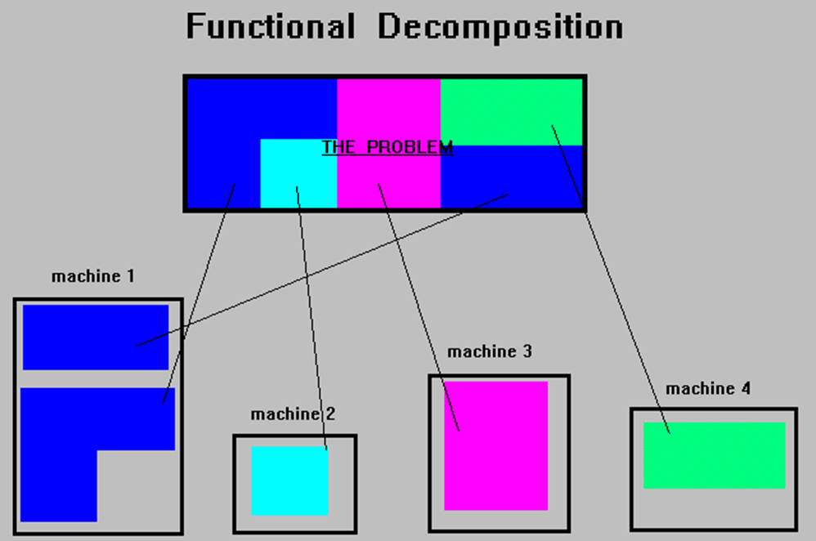
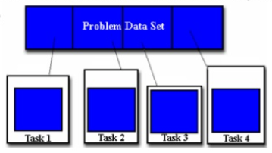
Ways for Parallelism
Functional Decomposition (Functional Parallelism)
Decomposing the problem into different tasks which can be distributed to multiple processors for simultaneous execution
Good to use when there is not static structure or fixed determination of number of calculations to be performed
Domain Decomposition (Data Parallelism)
Partitioning the problem's data domain and distributing portions to multiple processors for simultaneous execution
Good to use for problems where:
data is static (factoring and solving large matrix or finite difference calculations)
dynamic data structure tied to single entity where entity can be subsetted (large multi-body problems)
domain is fixed but computation within various regions of the domain is dynamic (fluid vortices models)

Slide 53
Parallel Programming Paradigm
Phase parallel
Divide and conquer
Pipeline
Process farm
Work pool
Note:
The parallel program consists of number of super steps, and each super step has two phases : computation phase and interaction phase

Slide 54
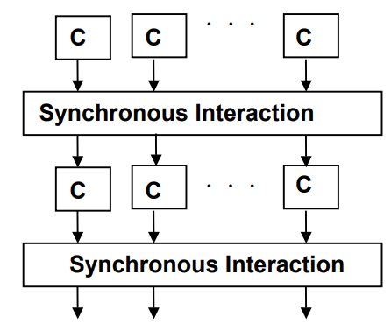
Phase Parallel Model
The phase-parallel model offers a paradigm that is widely used in parallel programming.
The parallel program consists of a number of supersteps, and each has two phases.
In a computation phase, multiple processes each perform an independent computation C.
In the subsequent interaction phase, the processes perform one or more synchronous interaction operations, such as a barrier or a blocking communication.
Then next superstep is executed.

Slide 55
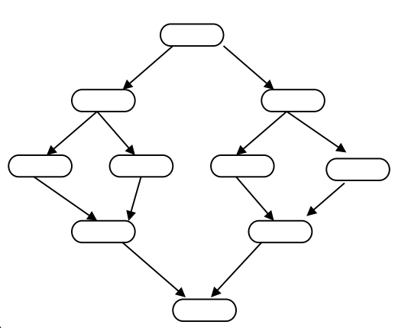
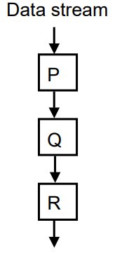
Divide and Conquer & Pipeline model
A parent process divides its workload into several smaller pieces and assigns them to a number of child processes.
The child processes then compute their workload in parallel and the results are merged by the parent.
The dividing and the merging procedures are done recursively.
This paradigm is very natural for computations such as quick sort.
Pipeline
In pipeline paradigm, a number of processes form a virtual pipeline.
A continuous data stream is fed into the pipeline, and the processes execute at different pipeline stages simultaneously in an overlapped fashion.

Slide 56
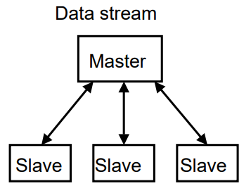
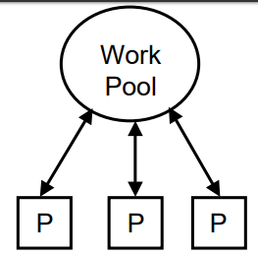
Process Farm & Work Pool Model
This paradigm is also known as the master-slave paradigm.
A master process executes the essentially sequential part of the parallel program and spawns a number of slave processes to execute the parallel workload.
When a slave finishes its workload, it informs the master which assigns a new workload to the slave.
This is a very simple paradigm, where the coordination is done by the master.
This paradigm is often used in a shared variable model.
A pool of works is realized in a global data structure.
A number of processes are created. Initially, there may be just one piece of work in the pool.
Any free process fetches a piece of work from the pool and executes it, producing zero, one, or more new work pieces put into the pool. The parallel program ends when the work pool becomes empty.
This paradigm facilitates load balancing, as the workload is dynamically allocated to free processes.

Slide 57
Parallel Program using Python
A thread is basically an independent flow of execution. A single process can consist of multiple threads. Each thread in a program performs a particular task. For Example, when you are playing a game say FIFA on your PC, the game as a whole is a single process, but it consists of several threads responsible for playing the music, taking input from the user, running the opponent synchronously, etc.
Threading is that it allows a user to run different parts of the program in a concurrent manner and make the design of the program simpler.
Multithreading in Python can be achieved by importing the threading module.
Example:
import threading
from threading import *

Slide 58
Parallel program using Threads in Python
# simplest way to use a Thread is to instantiate it with a target function and call start() to let it begin working.
from threading import Thread,current_thread
print(current_thread().getName())
def mt():
print("Child Thread")
for i in range(11,20):
print(i*2)
def disp():
for i in range(10):
print(i*2)
child=Thread(target=mt)
child.start()
disp()
print("Executing thread name :",current_thread().getName())
from threading import Thread,current_thread
class mythread(Thread):
def run(self):
for x in range(7):
print("Hi from child")
a = mythread()
a.start()
a.join()
print("Bye from",current_thread().getName())

Slide 59
Parallel program using Process in Python
import multiprocessing
def worker(num):
print('Worker:', num)
for i in range(num):
print(i)
return
jobs = []
for i in range(1,5):
p = multiprocessing.Process(target=worker, args=(i+10,))
jobs.append(p)
p.start()

Slide 60
Concurrent Programming Paradigm
Computing systems model the world, and the world contains actors that execute independently of, but communicate with, each other. In modelling the world, many (possibly) parallel executions have to be composed and coordinated, and that's where the study of concurrency comes in.
There are two common models for concurrent programming: shared memory and message passing.
Shared memory. In the shared memory model of concurrency, concurrent modules interact by reading and writing shared objects in memory.
Message passing. In the message-passing model, concurrent modules interact by sending messages to each other through a communication channel. Modules send off messages, and incoming messages to each module are queued up for handling

Slide 61
Issues Concurrent Programming Paradigm
Concurrent programming is programming with multiple tasks. The major issues of concurrent programming are:
Sharing computational resources between the tasks;
Interaction of the tasks.
Objects shared by multiple tasks have to be safe for concurrent access. Such objects are called protected. Tasks accessing such an object interact with each other indirectly through the object.
An access to the protected object can be:
Lock-free, when the task accessing the object is not blocked for a considerable time;
Blocking, otherwise.
Blocking objects can be used for task synchronization. To the examples of such objects belong:
Events;
Mutexes and semaphores;
Waitable timers;
Queues

Slide 62
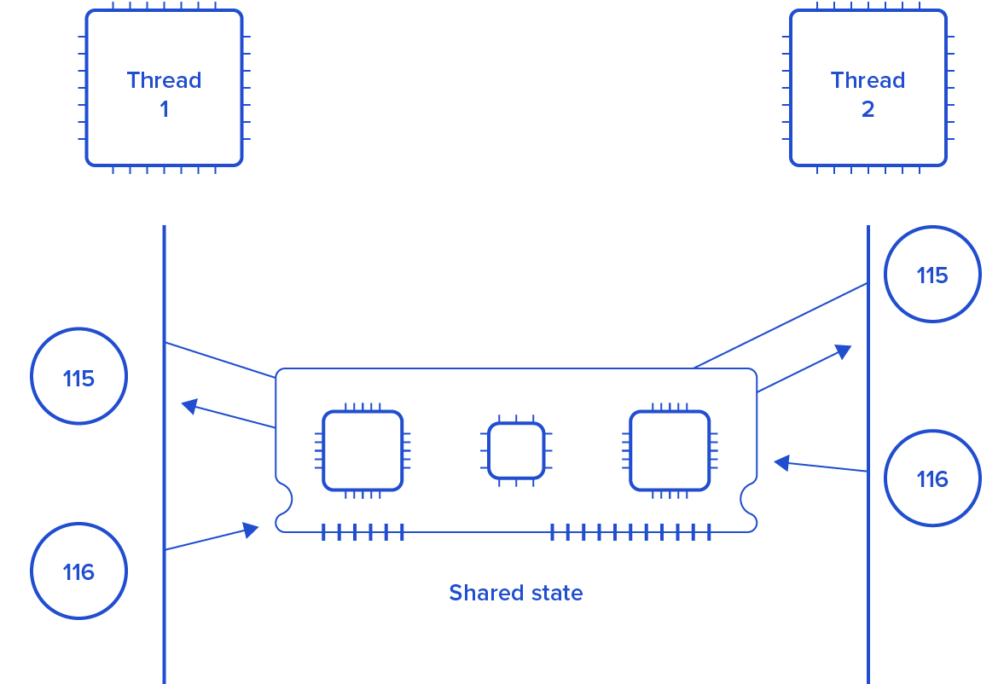
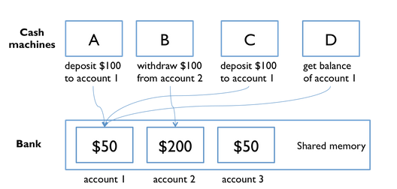
Issues Concurrent Programming Paradigm

Slide 63
Race Condition
import threading
x = 0 # A shared value
COUNT = 100
def incr():
global x
for i in range(COUNT):
x += 1
print(x)
def decr():
global x
for i in range(COUNT):
x -= 1
print(x)
t1 = threading.Thread(target=incr)
t2 = threading.Thread(target=decr)
t1.start()
t2.start()
t1.join()
t2.join()
print(x)

Slide 64
Synchronization in Python
Locks:
Locks are perhaps the simplest synchronization primitives in Python. A Lock has only two states — locked and unlocked (surprise). It is created in the unlocked state and has two principal methods — acquire() and release(). The acquire() method locks the Lock and blocks execution until the release() method in some other co-routine sets it to unlocked.
R-Locks:
R-Lock class is a version of simple locking that only blocks if the lock is held by another thread. While simple locks will block if the same thread attempts to acquire the same lock twice, a re-entrant lock only blocks if another thread currently holds the lock.
Semaphore:
A semaphore has an internal counter rather than a lock flag, and it only blocks if more than a given number of threads have attempted to hold the semaphore. Depending on how the semaphore is initialized, this allows multiple threads to access the same code section simultaneously.

Slide 65
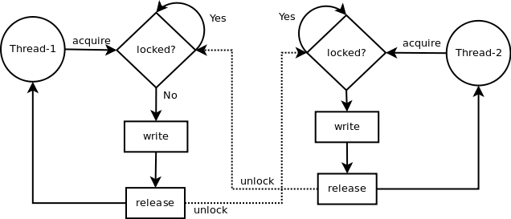
LOCK in python
Synchronization using LOCK
Locks have 2 states: locked and unlocked. 2 methods are used to manipulate them: acquire() and release(). Those are the rules:
if the state is unlocked: a call to acquire() changes the state to locked.
if the state is locked: a call to acquire() blocks until another thread calls release().
if the state is unlocked: a call to release() raises a RuntimeError exception.
if the state is locked: a call to release() changes the state to unlocked().

Slide 66
Synchronization in Python using Lock
import threading
x = 0 # A shared value
COUNT = 100
lock = threading.Lock()
def incr():
global x
lock.acquire()
print("thread locked for increment cur x=",x)
for i in range(COUNT):
x += 1
print(x)
lock.release()
print("thread release from increment cur x=",x)
def decr():
global x
lock.acquire()
print("thread locked for decrement cur x=",x)
for i in range(COUNT):
x -= 1
print(x)
lock.release()
print("thread release from decrement cur x=",x)
t1 = threading.Thread(target=incr)
t2 = threading.Thread(target=decr)
t1.start()
t2.start()
t1.join()
t2.join()

Slide 67
Synchronization in Python using RLock
import threading
class Foo(object):
lock = threading.RLock()
def __init__(self):
self.x = 0
def add(self,n):
with Foo.lock:
self.x += n
def incr(self):
with Foo.lock:
self.add(1)
def decr(self):
with Foo.lock:
self.add(-1)
def adder(f,count):
while count > 0:
f.incr()
count -= 1
def subber(f,count):
while count > 0:
f.decr()
count -= 1
# Create some threads and make sure it works
COUNT = 10
f = Foo()
t1 = threading.Thread(target=adder,args=(f,COUNT))
t2 = threading.Thread(target=subber,args=(f,COUNT))
t1.start()
t2.start()
t1.join()
t2.join()
print(f.x)

Slide 68
Synchronization in Python using Semaphore
import threading
import time
done = threading.Semaphore(0)
item = None
def producer():
global item
print "I'm the producer and I produce data."
print "Producer is going to sleep."
time.sleep(10)
item = "Hello"
print "Producer is alive. Signaling the consumer."
done.release()
def consumer():
print "I'm a consumer and I wait for data."
print "Consumer is waiting."
done.acquire()
print "Consumer got", item
t1 = threading.Thread(target=producer)
t2 = threading.Thread(target=consumer)
t1.start()
t2.start()

Slide 69
Synchronization in Python using event
import threading
import time
item = None
# A semaphore to indicate that an item is available
available = threading.Semaphore(0)
# An event to indicate that processing is complete
completed = threading.Event()
# A worker thread
def worker():
while True:
available.acquire()
print "worker: processing", item
time.sleep(5)
print "worker: done"
completed.set()
# A producer thread
def producer():
global item
for x in range(5):
completed.clear() # Clear the event
item = x # Set the item
print "producer: produced an item"
available.release() # Signal on the semaphore
completed.wait()
print "producer: item was processed"
t1 = threading.Thread(target=producer)
t1.start()
t2 = threading.Thread(target=worker)
t2.setDaemon(True)
t2.start()

Slide 70
Producer and Consumer problem using thread
import threading,time,Queue
items = Queue.Queue()
# A producer thread
def producer():
print "I'm the producer"
for i in range(30):
items.put(i)
time.sleep(1)
# A consumer thread
def consumer():
print "I'm a consumer", threading.currentThread().name
while True:
x = items.get()
print threading.currentThread().name,"got", x
time.sleep(5)
# Launch a bunch of consumers
cons = [threading.Thread(target=consumer)
for i in range(10)]
for c in cons:
c.setDaemon(True)
c.start()
# Run the producer
producer()

Slide 71
Producer and Consumer problem using thread
import threading
import time
# A list of items that are being produced. Note: it is actually
# more efficient to use a collections.deque() object for this.
items = []
# A condition variable for items
items_cv = threading.Condition()
def producer():
print "I'm the producer"
for i in range(30):
with items_cv: # Always must acquire the lock first
items.append(i) # Add an item to the list
items_cv.notify() # Send a notification signal
time.sleep(1)
def consumer():
print "I'm a consumer", threading.currentThread().name
while True:
with items_cv: # Must always acquire the lock
while not items: # Check if there are any items
items_cv.wait() # If not, we have to sleep
x = items.pop(0) # Pop an item off
print threading.currentThread().name,"got", x
time.sleep(5)
cons = [threading.Thread(target=consumer)
for i in range(10)]
for c in cons:
c.setDaemon(True)
c.start()
producer()

Slide 72
Network Programming Paradigm

Slide 73
Introduction
The Network paradigm involves thinking of computing in terms of a client, who is essentially in need of some type of information, and a server, who has lots of information and is just waiting to hand it out. Typically, a client will connect to a server and query for certain information. The server will go off and find the information and then return it to the client.
In the context of the Internet, clients are typically run on desktop or laptop computers attached to the Internet looking for information, whereas servers are typically run on larger computers with certain types of information available for the clients to retrieve. The Web itself is made up of a bunch of computers that act as Web servers; they have vast amounts of HTML pages and related data available for people to retrieve and browse. Web clients are used by those of us who connect to the Web servers and browse through the Web pages.
Network programming uses a particular type of network communication known as sockets. A socket is a software abstraction for an input or output medium of communication.

Slide 74
What is Socket?
A socket is a software abstraction for an input or output medium of communication.
Sockets allow communication between processes that lie on the same machine, or on different machines working in diverse environment and even across different continents.
A socket is the most vital and fundamental entity. Sockets are the end-point of a two-way communication link.
An endpoint is a combination of IP address and the port number.
For Client-Server communication,
Sockets are to be configured at the two ends to initiate a connection,
Listen for incoming messages
Send the responses at both ends
Establishing a bidirectional communication.

Slide 75
Socket Types
Datagram Socket
A datagram is an independent, self-contained piece of information sent over a network whose arrival, arrival time, and content are not guaranteed. A datagram socket uses User Datagram Protocol (UDP) to facilitate the sending of datagrams (self-contained pieces of information) in an unreliable manner. Unreliable means that information sent via datagrams isn't guaranteed to make it to its destination.
Stream Socket:
A stream socket, or connected socket, is a socket through which data can be transmitted continuously. A stream socket is more akin to a live network, in which the communication link is continuously active. A stream socket is a "connected" socket through which data is transferred continuously.

Slide 76
Socket in Python
sock_obj = socket.socket( socket_family, socket_type, protocol=0)
socket_family: - Defines family of protocols used as transport mechanism.
Either AF_UNIX, or
AF_INET (IP version 4 or IPv4).
socket_type: Defines the types of communication between the two end-points.
SOCK_STREAM (for connection-oriented protocols, e.g., TCP), or
SOCK_DGRAM (for connectionless protocols e.g. UDP).
protocol: We typically leave this field or set this field to zero.
Example:
#Socket client example in python
import socket
#create an AF_INET, STREAM socket (TCP)
s = socket.socket(socket.AF_INET, socket.SOCK_STREAM)
print 'Socket Created'

Slide 77
Socket Creation
import socket
import sys
try:
#create an AF_INET, STREAM socket (TCP)
s = socket.socket(socket.AF_INET, socket.SOCK_STREAM)
except socket.error, msg:
print 'Failed to create socket. Error code: ' + str(msg[0]) + ' , Error message : ' + msg[1]
sys.exit();
print 'Socket Created'

Slide 78
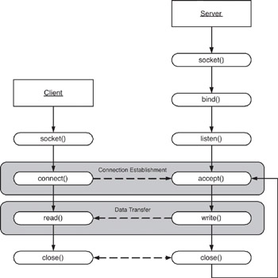
Client/server symmetry in Sockets applications

Slide 79
Socket in Python
To create a socket, we must use socket.socket() function available in the Python socket module, which has the general syntax as follows:
S = socket.socket(socket_family, socket_type, protocol=0)
socket_family: This is either AF_UNIX or AF_INET. We are only going to talk about INET sockets in this tutorial, as they account for at least 99% of the sockets in use.
socket_type: This is either SOCK_STREAM or SOCK_DGRAM.
Protocol: This is usually left out, defaulting to 0.
Client Socket Methods
Following are some client socket methods:
connect( ) : To connect to a remote socket at an address. An address format(host, port) pair is used for AF_INET address family.

Slide 80
Socket in Python
Server Socket Methods
bind( ): This method binds the socket to an address. The format of address depends on socket family mentioned above(AF_INET).
listen(backlog) : This method listens for the connection made to the socket. The backlog is the maximum number of queued connections that must be listened before rejecting the connection.
accept( ) : This method is used to accept a connection. The socket must be bound to an address and listening for connections. The return value is a pair(conn, address) where conn is a new socket object which can be used to send and receive data on that connection, and address is the address bound to the socket on the other end of the connection.

Slide 81
General Socket in Python
sock_object.recv():
Use this method to receive messages at endpoints when the value of the protocol parameter is TCP.
sock_object.send():
Apply this method to send messages from endpoints in case the protocol is TCP.
sock_object.recvfrom():
Call this method to receive messages at endpoints if the protocol used is UDP.
sock_object.sendto():
Invoke this method to send messages from endpoints if the protocol parameter is UDP.
sock_object.gethostname():
This method returns hostname.
sock_object.close():
This method is used to close the socket. The remote endpoint will not receive data from this side.

Slide 82
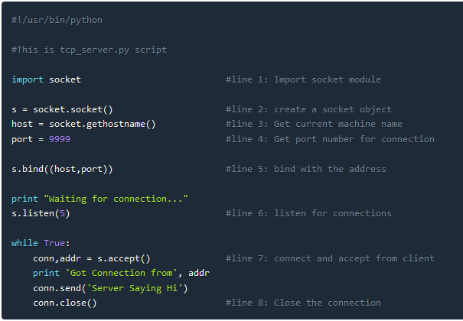
Simple TCP Server

Slide 83
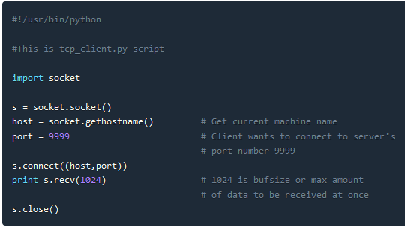
Simple TCP Client

Slide 84
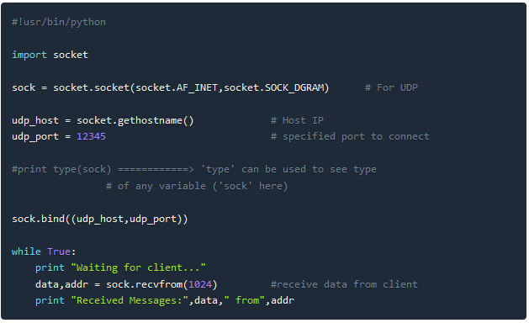
Simple UDP Server

Slide 85
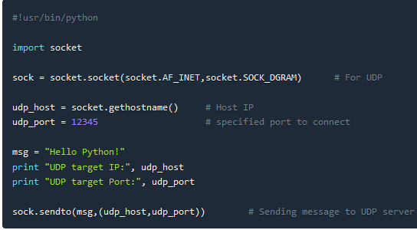
Simple UDP Client

